Slide 1
Virtual Library System
Group: Midnight Kamikaze Pilots™ Members: Josh Gaston, John Carroll, Chase Counsell, Ryon Campbell, Wan Lau

Slide 2
Presentation Outline
(c) Conceptual domain model (class diagram) derived from the concept statement
(d) Use case diagram (including dependencies among the use cases)
(e) One selected essential use case (in two column format), one scenario selected from the essential use case, and the corresponding High level SSD for the scenario
(f) The concrete/refined version of the selected use case, its Detailed SSD
(g) A selected statechart derived directly from the SSDs
(h) Consolidated class model (domain class + application class model)
(i) Model review - elaborate on the quality of your model based on the completeness, correctness, and consistency criteria

Slide 3
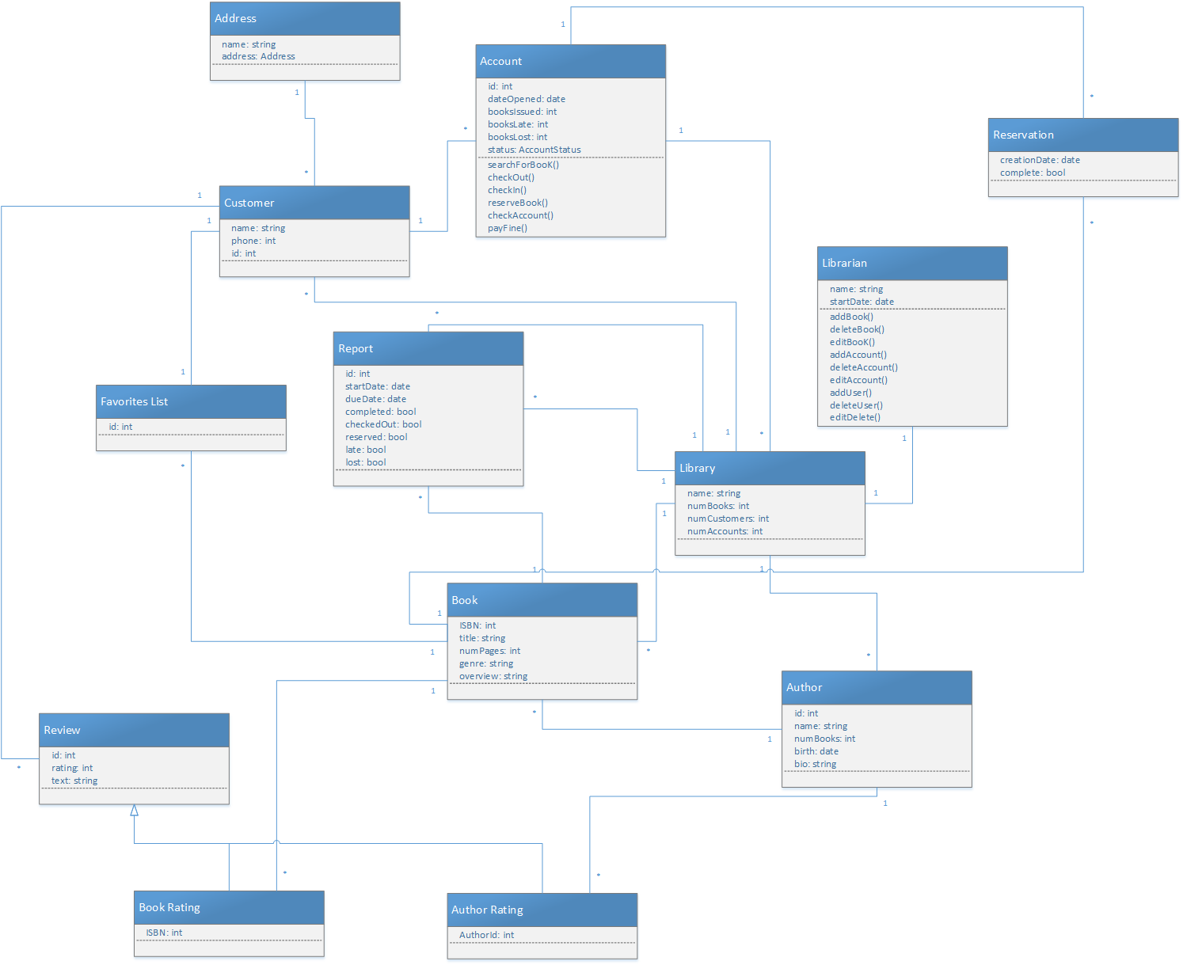
(c) Conceptual Domain Model

Slide 4
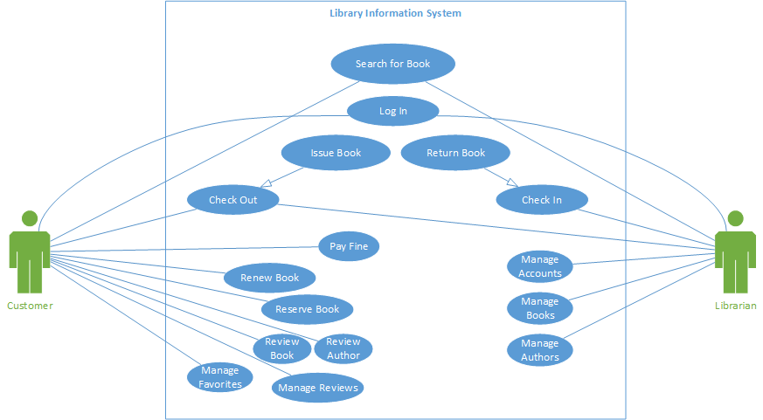
(d) Use Case Diagram

Slide 5
(e) Essential Use Case: Pay Fine
Pay Fine: User pays any outstanding fines that are associated to their account.
Pay Fine - Scenario:
A customer logs into his account
He clicks into his account summary/ user info page
He sees that he has an outstanding fine on his page
He clicks the Pay Fine buttom on that page
The customer then has paid the fine on his account with his associated credit card

Slide 6
(e) Essential Use Case: Pay Fine (two-column format)
Customer | System
Customer logs into account Clicks into his account summary/ user info page Sees that he has an outstanding fine on his page He clicks the Pay Fine buttom on that page The customer then has paid the fine on his account with his associated credit card Customer logs out of account | Logs in okay Displays account summary Processes payment Confirms payment

Slide 7
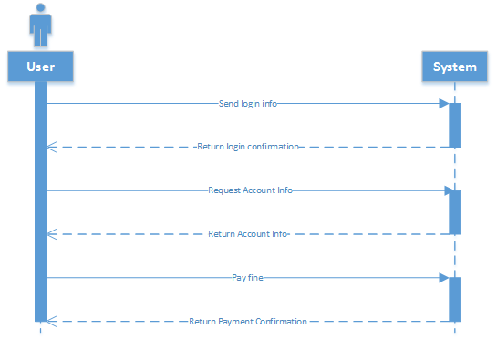
(e) Essential Use Case: Pay Fine - High level SSD

Slide 8
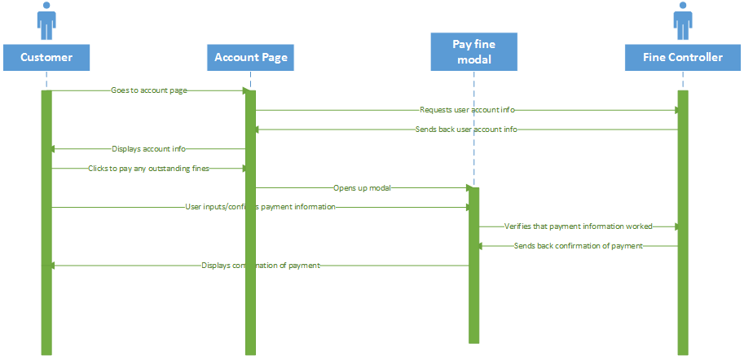
(f) Concrete Use Case: Pay Fine - Detailed SSD
Pay fine: the customer can navigate to their account summary page from the customer menu whereby the customer may then view their outstanding fines and if there are any they can click the pay button to send a charge to the credit card associated with their account. (Boundary Objects: Account Page, Pay fine modal Control Objects: Fine Controller Entity: Customer)

Slide 9
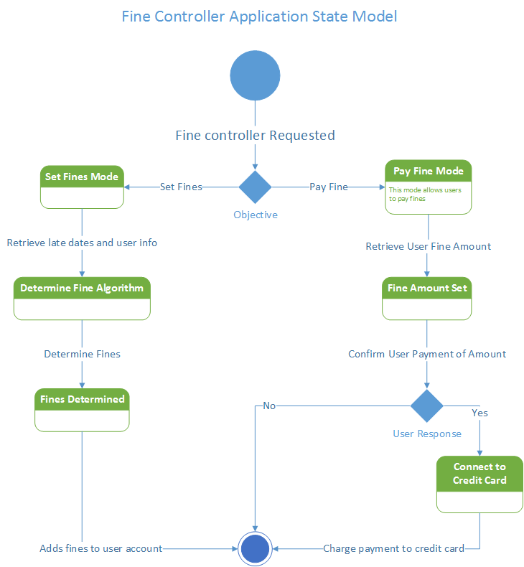
(g) Selected Statechart Derived From SSDs

Slide 10
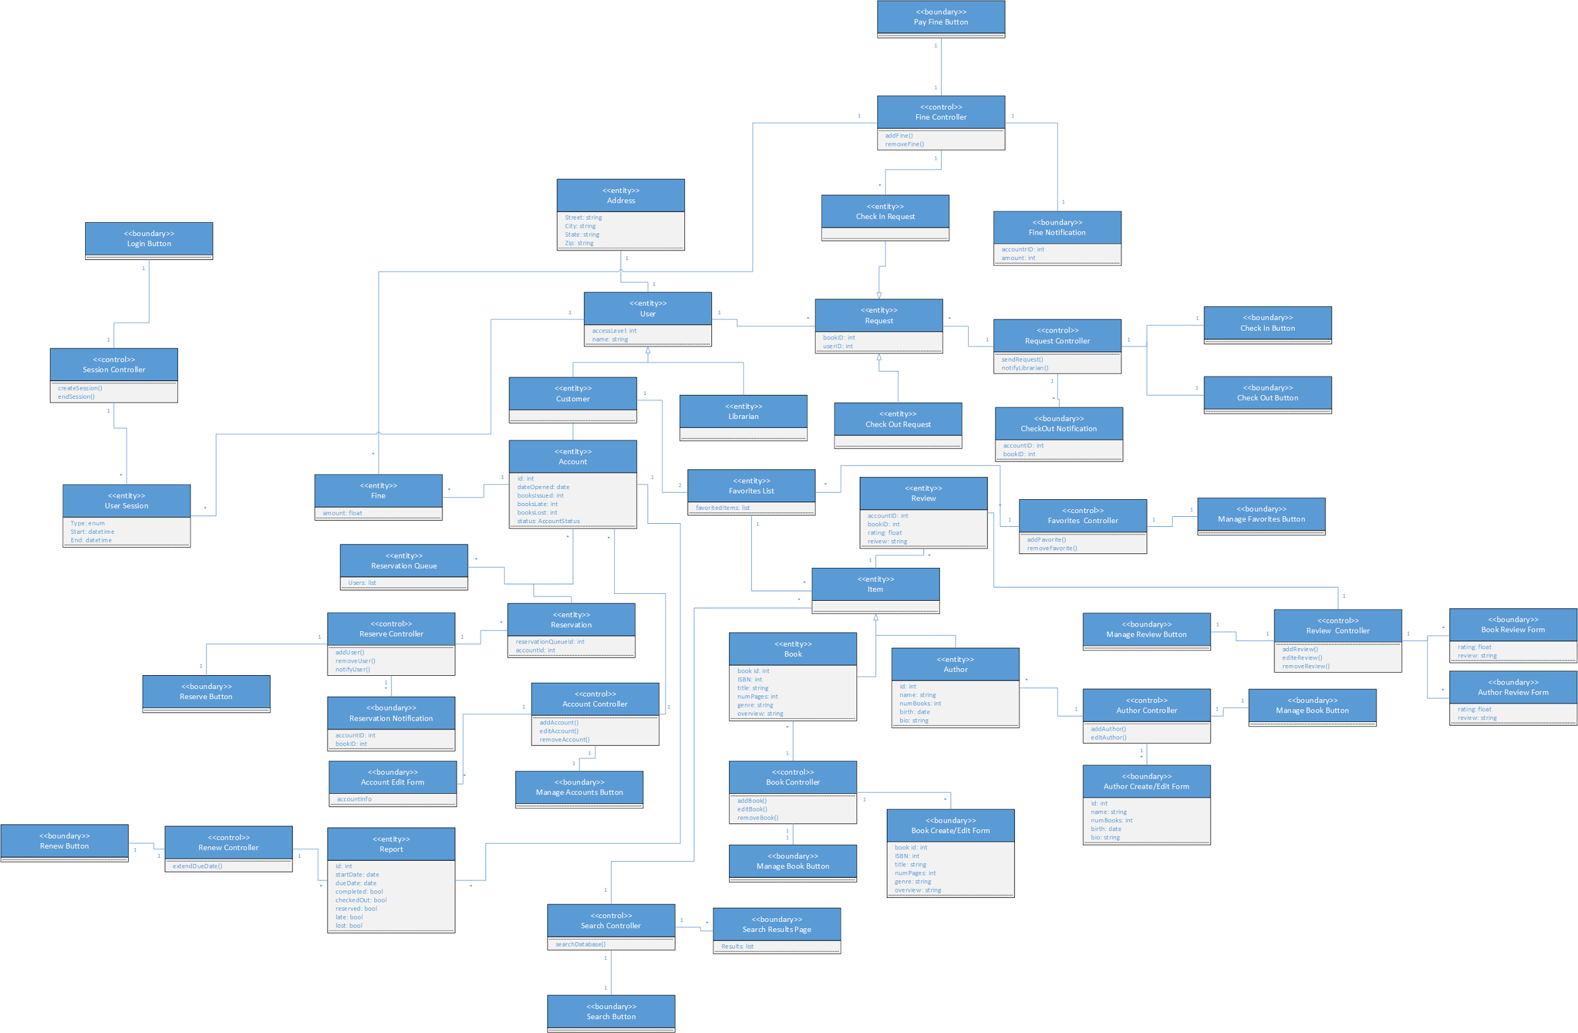
(h) Consolidated Class Model (Domain Class + Application Class Model)

Slide 11
(i) Model Review
When modeling any system, it is very important to judge the resulting model’s
correctness, completeness, and consistency. We considered these when creating and judging
our models.
For correctness, the model for our system performs well. Our boundary and entity
objects all have descriptive nouns for names. Our use cases all have descriptive verbs for
names. The descriptions fit well with our concept statement.
We worked on checking the completeness of our model by checking the attributes and
events in each of our objects to make sure it was correct. We used linguistic analysis on both our use cases and concept statement to gather all potential classes and associations in the domain.
We were constantly checking the consistency of our model. There aren’t any classes or
cases with the same names. When choosing names we made sure that similar names will have
a similar concept. We also simplified some classes that have the same attributes by placing
them in a generalization relationship.

